Slide 1
Get ready for Swivel-Seat Communications:
Tips and Advice on Integrated Content Development in the Age of Mobile, Lean and CXM
Connie Giordano
Executive Editor
TechWhirl / INKtopia

Slide 2
Connie Giordano
One-half of INKtopia Limited, publishers of TechWhirl
Dual role as Executive Editor of TechWhirl, and consultant/content services provider via INKtopia
Masters, Organizational Communication, Queens University
25 years in technical and marketing communications
Cross-functional experience in knowledge management, process design, and business analysis
Expertise in editing, journalism and tech comm industries
@CPGiordano connie@inktopia.net www.linkedin.com/in/conniegiordano

Slide 3
Communications at a Crossroads
Universal truths and continuing questions
Content is a business asset, but not everyone charged with creating content is suited to the task.
Content is important, but are the content creators?
Size matters, small to medium-size business lack the budget and the staff to separate content creation duties.
Titles don’t matter nearly as much as we think.
We have started viewing content creation through different lenses, while being pressured to maximize reuse.

Slide 4
Swivel Seat Communications
Swivel seat support in IT infrastructure and operations support frameworks.
Continuously move between roles and functions to address the needs, problems, issues of internal or external customers.
“Nimble,” “Agile,” “Disruptive,” and “Customer-centric” organizations probably already swivel to some degree.

Slide 5
The Content Lifecycle
Create
Manage
Publish
Preserve/ Retrieve
Evaluate

Slide 6
Swiveling in Multiple Dimensions
Between creation, production, and delivery of content
Between marketing, sales, support, tech pubs, operations, finance, HR ….
Between internal development and customer-facing roles
Between strategy and tactics
Between planning and implementation

Slide 7
Culture & Convergence
Will you be assimilated?
Organizational culture drives how content is managed, and how to change the process.
If you think marketers are encroaching on the traditional territory of tech writers… you’re right
Jim Burns’ (Avitage) encourages marketers to adopt a continuous content publishing process.

Slide 8
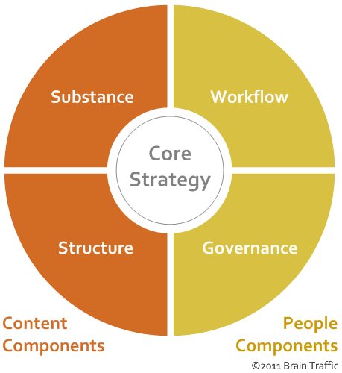
Strategy, Planning and Tactics
Check out Brain Traffic’s Content Quad
A useful way to think about how to get from business goals and brand strategy to actual content assets.
Even though it’s a quad, it applies the same principles as the content triangle we cover on TechWhirl.

Slide 9
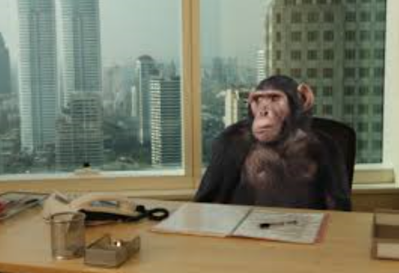
Continually Evolving Expertise
Subject matter experts = content masters
Keeping up with the Joneses, and the Klingons, and the universe in general requires curiosity, and more than a little time.
Research and interviewing skills are critical

Slide 10
Tip #1: Inventory, Audit, & Introduce
Boldly go into those repositories and see what’s there.
Find out what leadership’s priorities are, and inventory the content to understand what you have, and what condition it’s in.
Start networking with others who create content for the firm.

Slide 11
Tip #2: If You Lack the Budget, Go Low-Tech
When you can’t get the latest and greatest, make do with manual or nearly manual processes.
Understand the processes-as they are now.
Make the tools you have do what you want them to do.

Slide 12
Tip #3: Get Proactive
Don’t wait to be asked
Don’t get offended by “Make it pretty.” Make it pretty and useful.
See something that’s broken? Offer to fix it.
See something that’s useful? Offer to share it.
Meet your colleagues, virtually or in person, and learn what makes them tick

Slide 13
Tip #4: Go for Practical & Iterative Planning
Create a strategy for a project, before going enterprise wide.
Build processes within your team before attempting cross-functional efforts.
Plan a major project in phases, and manage each phase as its own effort.
Document the good and the bad, and use it to get better.
Ask around for information on how other teams in the firm have done it.

Slide 14
Tip #5: Keep Learning … everything
What other functions and roles should you understand in order to produce better, more consistent content?
What interests you?
Now see what’s out there to help you learn everything:
Webinars, tutorials, white papers abound.
Sign up for certificate programs
Consider a post-graduate degree
Join some forums where you’re not an expert.

Slide 15
Questions? Tips of Your Own?

Slide 16
A Recap
Communication functions are converging, and practitioners need to master tech writing, change management, support, marketing, corporate communications and more.
Future success depends on swiveling between roles and tasks with ease and effectiveness, even when you lack budget, resources, or particular expertise.
Tips
Inventory, audit and introduce
If you lack the budget, go low-tech
Get pro-active
Go practical and iterative with your planning
Keep learning … everything

Slide 17
Resources
TechWhirl
The discussion list
The website
The template library
Tools worth checking out:
Trello
Teamworks PM
Google Analytics
Slack
Professional Associations
STC
IABC
ASTD
UXPA
Articles:
The Help Desk Evolution: 3 Trends Affecting IT Support
Why Content Creation Isn’t Everyone’s Job
Users’ Advocate: Is our Technical Content UX? Yes!
Connie Giordano
connie@inktopia.net
@cpgiordano
www.linkedin.com/in/conniegiordano/en
@techwritertoday

